Slide 1

Data Engineering
Lakshay Agarwal
Emp ID: A785387

Slide 2




Technologies used:
Python (version 3.13.2)
DBT
Snowflake
Jira (version 10.3.2)
GitHub
Source: Google images

Slide 3
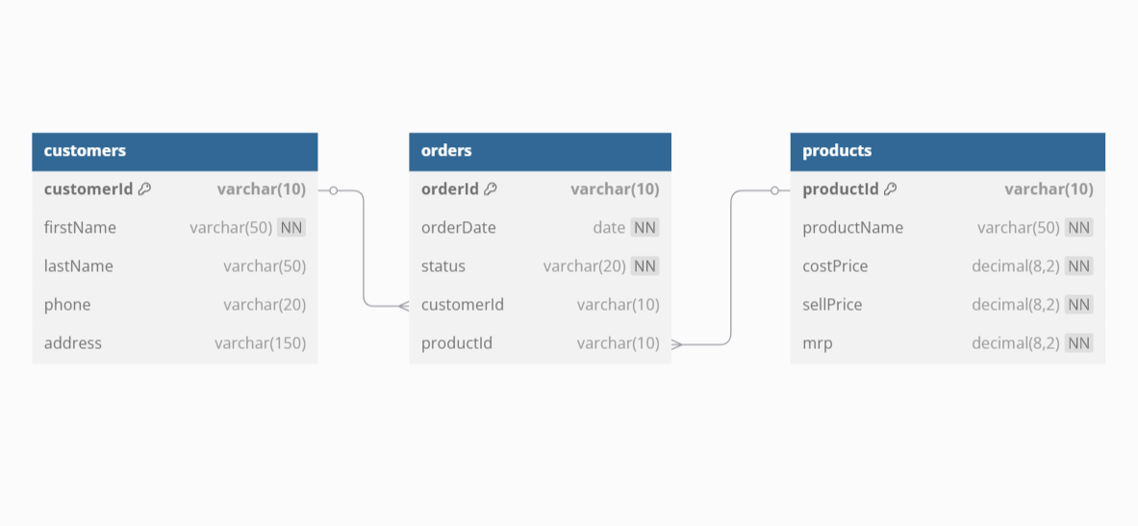
ER diagram:

Slide 4
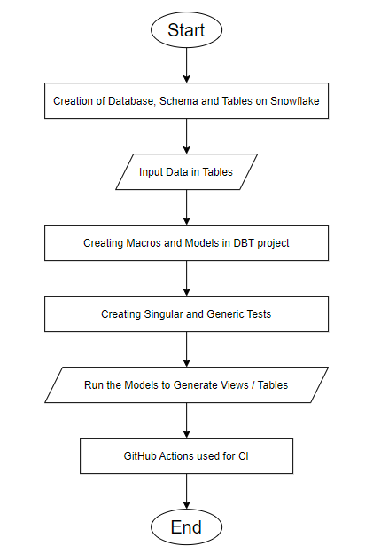
Flowchart:

Slide 5


